Slide 1
LLRF Progress at FRIB From Commissioning to Operation and Future
Shriraj Kunjir (kunjir@frib.msu.edu), Dan Morris, Shen Zhao
LLRF Workshop October 2025

Slide 2
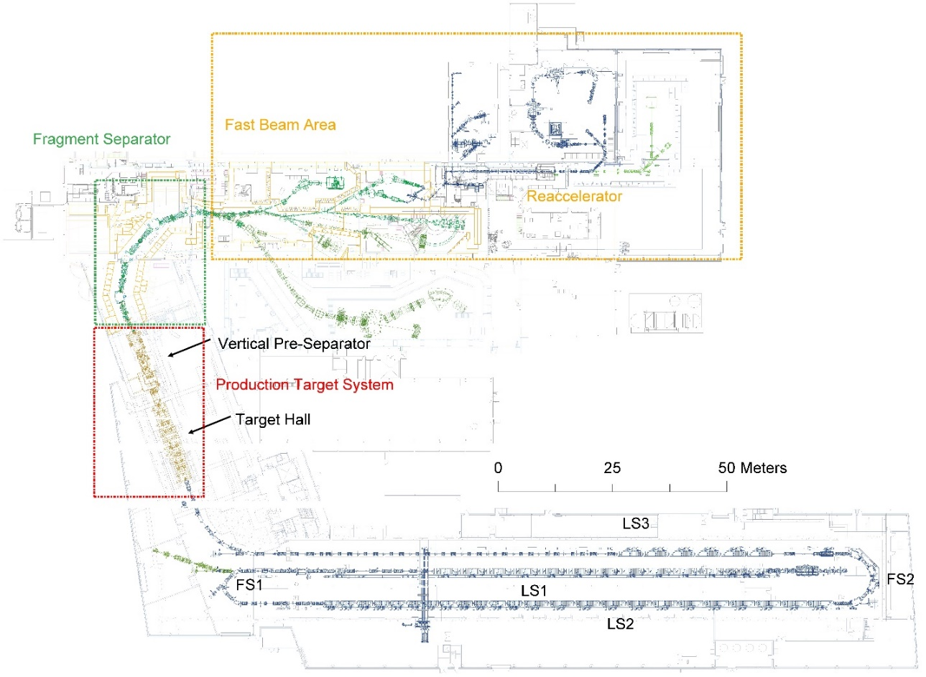
Outline
Lab Achievements
Operation
Performance and system uptime
Daily report and operation support
Breakdowns and trouble reports tracking
Typical Calibration Issues
Amplitude
Phase
Reference clock
Beam Based Feedback
Implementation
Use case
New LLRF Controller
Summary
FSEE Beam Line
Key Performance Parameters:
Beam energy: 200 MeV/u
Beam power: 400 kW

Slide 3
Lab Achievements
Record uranium beam intensity
FRIB successfully delivered a 20 kW uranium-238 beam on target during accelerator operations in March 2025
This record beam power doubled the previous world record of 10kW uranium beam power
Delivered a record 22 kW selenium-82 beam in July 2024, accelerating the beam to 228 MeV/u
Beam Power | Species | # of User Experiment | Year
1 kW | ⁴⁸Ca, ⁷⁰Zn, ⁸²Se | 3 | 2022
3 kW | ³⁶Ar, ¹²⁴Xe, ¹⁹⁸Pt | 5 | 2022
5 kW | ³⁶Ar, ⁴⁰Ar, ⁴⁸Ca, ⁶⁴Zn, ¹²⁴Xe | 15 | 2023
10 kW | ¹⁸O, ⁴⁰Ar, ²²Ne, ²⁸Si, ⁴⁸Ca, ⁸²Se, ¹²⁴Xe, ²³⁸U | 17 | 2023
20 kW | ¹⁸O, ²⁸Si, ⁴⁸Ca, ⁵⁸Ni, ⁶⁴Zn, ⁸²Se, ¹²⁴Xe, ²³⁸U | 19 | 2024
Thermal optical image of the uranium beams on the rotating production target during the 20 kW run. The 2.1 mm thick graphite target disc rotates counterclockwise at 500 rpm. The maximum temperature reached on the target is 1200 ºC

Slide 4
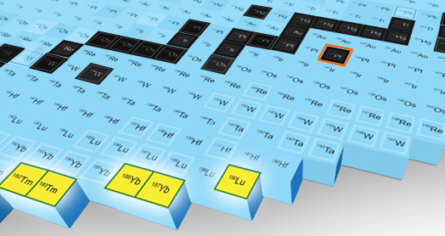
New Isotopes Observed
High-power uranium beam enabled FRIB to produce and identify gallium-88, arsenic-93 and selenium-96 within the first 24 h of operation
Beam required stable operation of all accelerator devices at the highest accelerating gradients
https://doi.org/10.1103/PhysRevAccelBeams.27.060101
FRIB discovered five never-before-seen heavy element isotopes: thulium-182 and 183, ytterbium-186 and 187, and lutetium-190
Found the new isotopes in the debris of collisions between a stable beam of platinum-198 and a carbon target
https://doi.org/10.1103/physrevlett.132.072501
First observed at FRIB
Stable
Known

Slide 5
Performance and System Uptime
FRIB facility downtime hours during scientific user operations by system category from October 2022 to September 2024
FRIB is required to schedule 4200 hours of beam time annually with > 85% availability for scientific operations. The overall availability of the facility is 93%. Total downtime in hours
The FRIB single event effect (FSEE) facility annually delivers ~2000 beam hours with a dedicated beamline downstream of Segment 1 of the driver linac
RF Availability > 98%
doi: 10.18429/JACoW-HIAT2025-MOX01

Slide 6
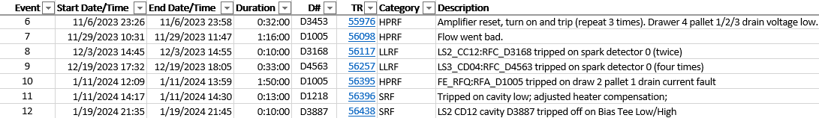
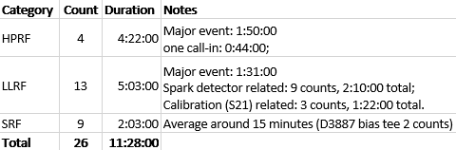
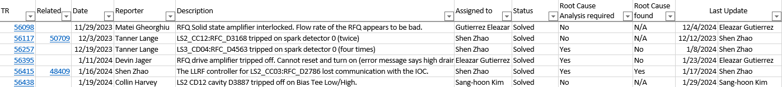
Breakdowns and Trouble Reports Closely Tracked
Nov 2023 ~ Apr 2024
SRF
HPRF (major event)
Troubleshooting: 15 minutes;
Drawer swap: 59 minutes;
RFQ recovery time: 36 minutes;
LLRF (major event)
Get to the right person: 26 minutes;
Commute: 25 minutes;
Fixing problem: 20 minutes; recovering cavity: 20 minutes;
Trouble reports
Typically solved within a week

Slide 7

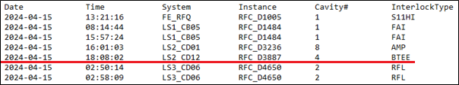
Daily Operation Support Streamlined
Automated cavity daily trip report
Python script to scan through archived data
Less than 5 minutes to generate the report
Fast waveform analysis for trips of concern
Bias tee (BTEE)
Cold cathode gauge (CCG)
Amplitude unlock (AULK)
Meet with superconducting RF
(SRF) group weekly
Analyzing new trip cases
Tracking repeated trips
Shift coverage (primary / backup)
Weekly RF group meeting
HPRF / LLRF shift coverage
Breakdown reports, repair status

Slide 8
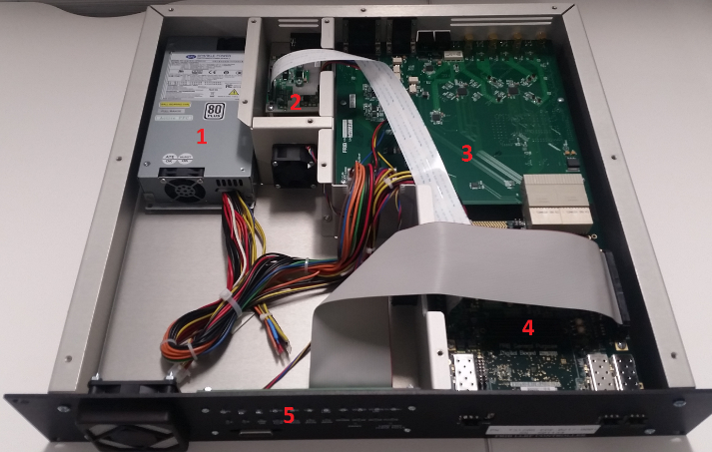
FRIB LLRF Controller
For more details refer to LLRF Workshop 2022 talk by Shen Zhao
Integrated design
Including RF control, tuner control and interlocks
Handles all FRIB cavity types
Frequencies: 40.25, 80.5, 120.75, 161 and 322 MHz
Tuners: 2 phase stepper motor, pneumatic tuner
RF design
Direct, non-IQ sampling and direct synthesis
Removing local oscillator and mixers
RF control algorithm
Supporting both self-excited loop mode and generator driven mode
Amplitude and phase control with active disturbance rejection control
Spare analog/digital inputs/outputs
E.g. high voltage bias on/off and monitoring
Fast waveform
Sampling period: ~ 0.8 µs; Block size: 64 bytes; Depth: 4 M samples (~3.3 seconds);
19” rack 2U height
1. Power supply; 2. Tuner board; 3. RF board; 4. FRIB general purpose digital board; 5. Front panel board.

Slide 9
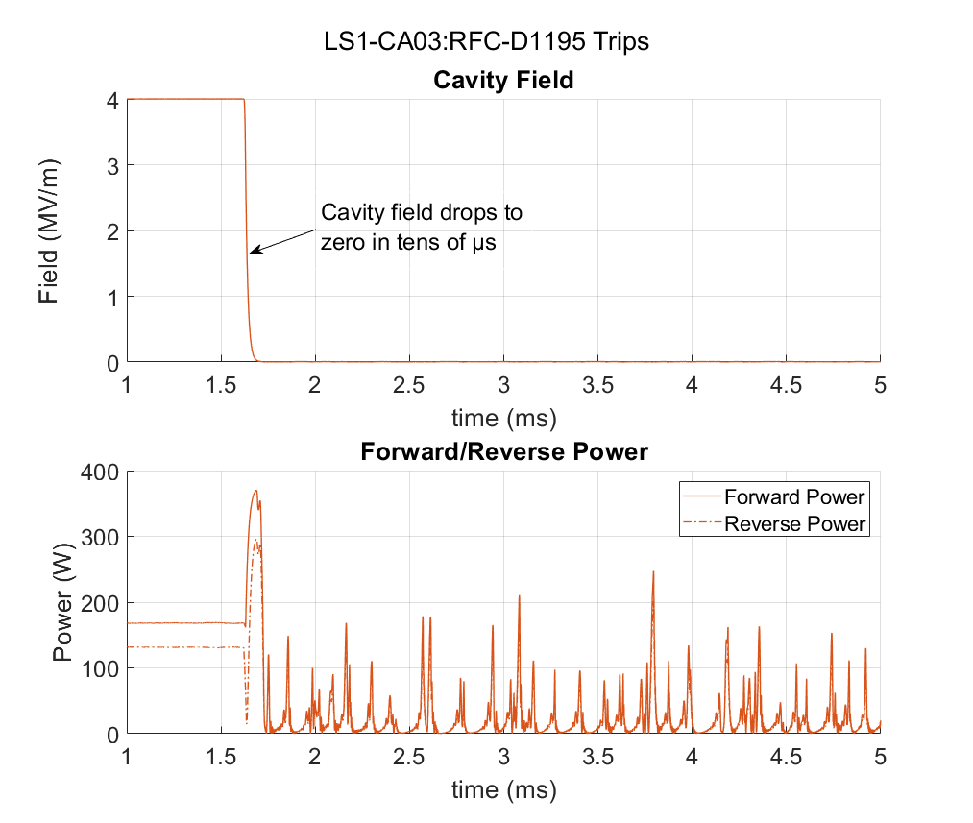
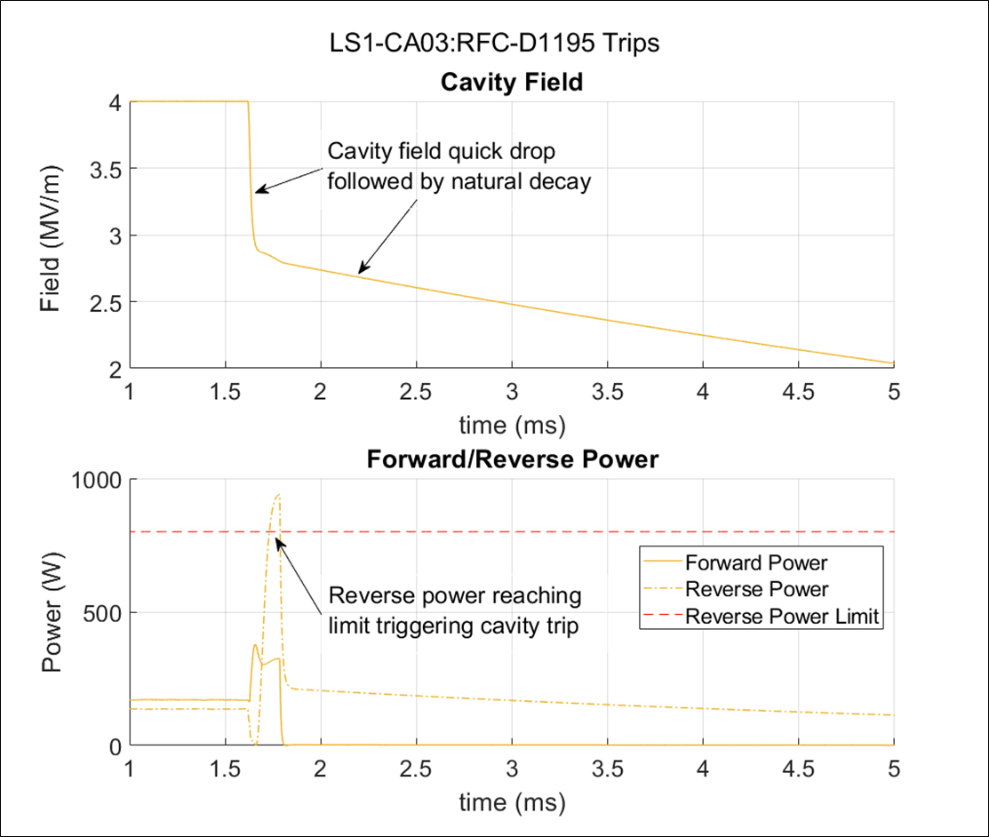
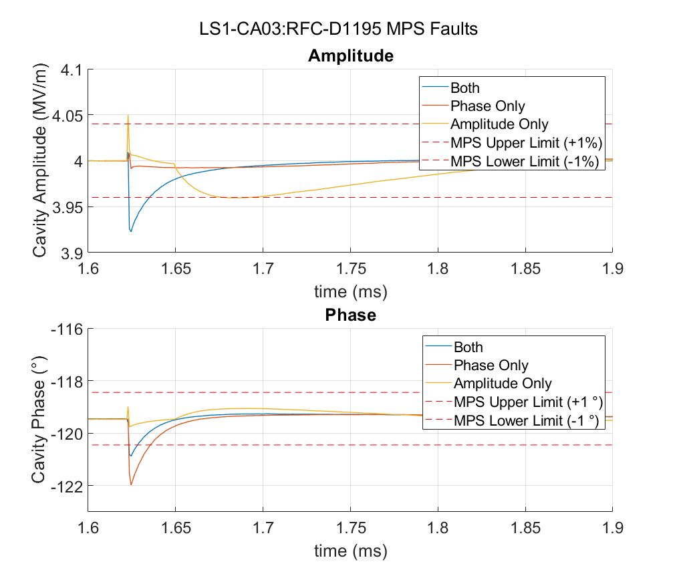
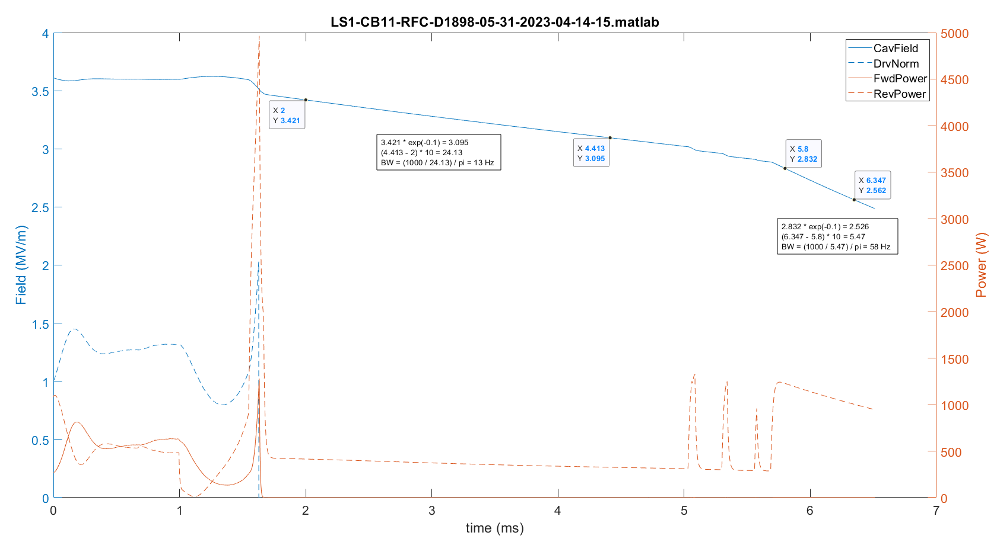
LLRF Fast Waveform Examples
Cavity Field Low Trip
Example 1
Reverse Power High Trip
Example 1: Differentiate between types of fast cavity field drops
Example 2: Detailed cavity amplitude and phase waveforms help to determine appropriate Machine Protection System trip thresholds
Example 3: Rare events captured such as cavity decay time change (Q change)
Example 2
Example 3

Slide 10
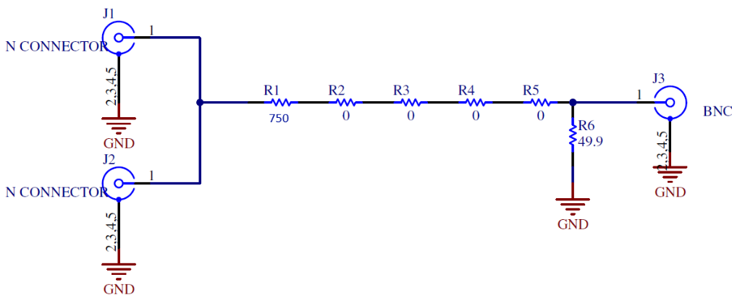
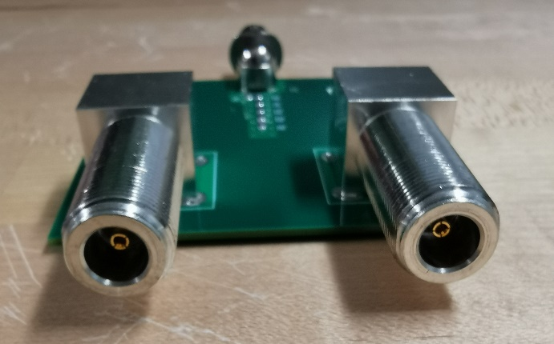
Typical LLRF Calibration Issues
Calibration changes
Amplitude: changes in interface panel insertion loss
Change in resistance measured between the center pin of the type-N connector and ground
Resolution: quick response procedure (cleaning) developed in Summer 2024
Root cause: cavity discharge event most likely the cause for failure. Still investigating
Phase: Bug inside firmware affects ~3% of the half wave resonator (HWR) LLRF controllers upon each reboot, hard to diagnose
Resolution: firmware bug fixed; establish baseline measurement for future reference
Root cause: Improper synchronization of counters in a look-up table based digital mixer
Interface panel PCB
Interface panel schematic

Slide 11
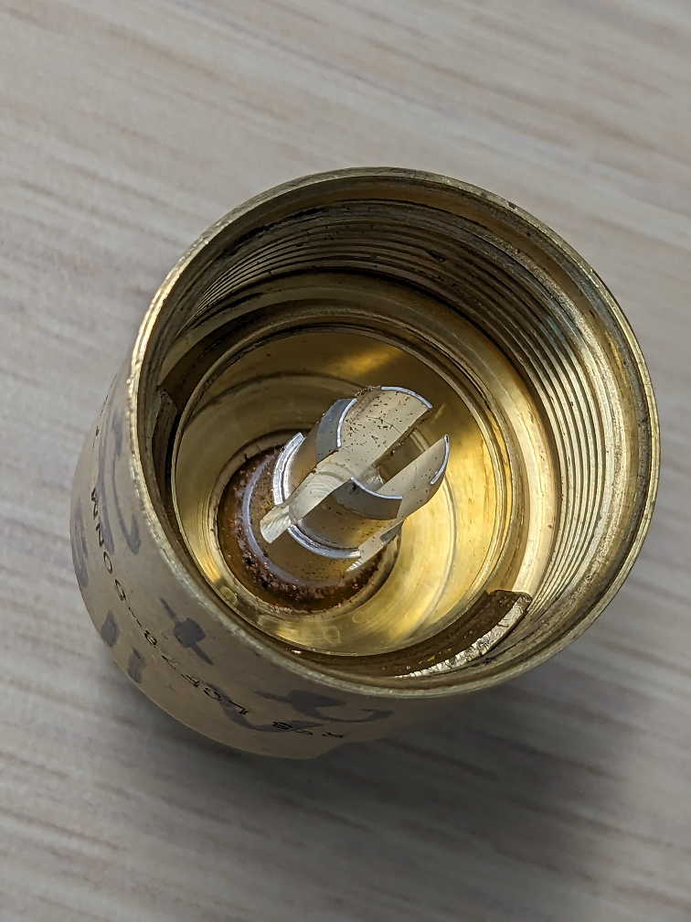
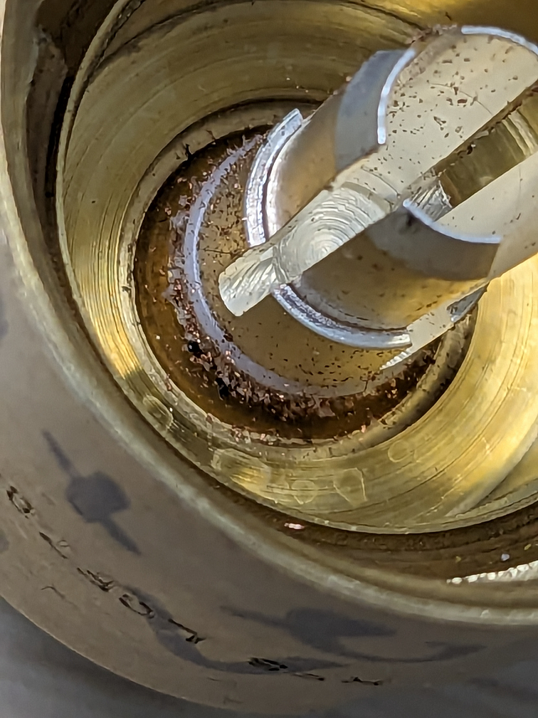
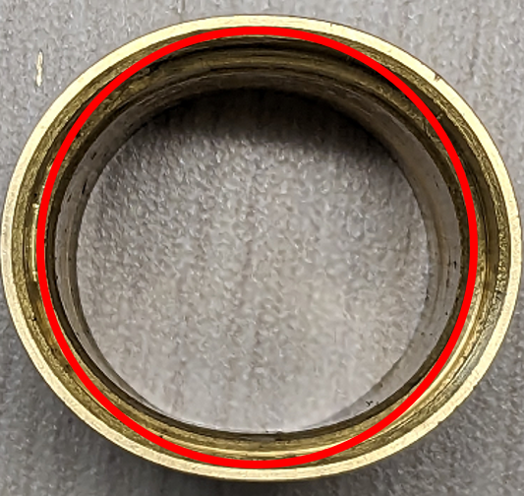
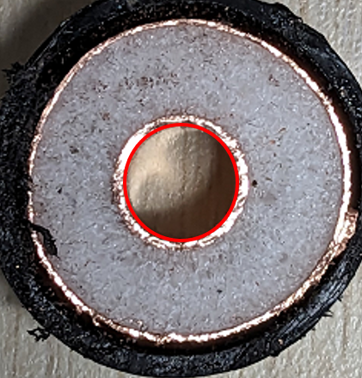
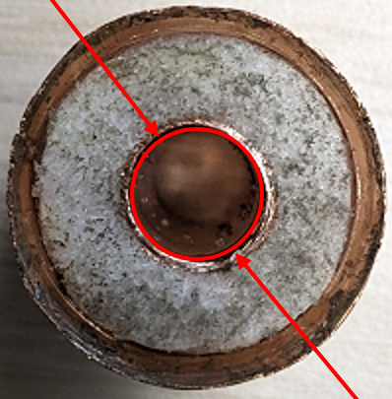
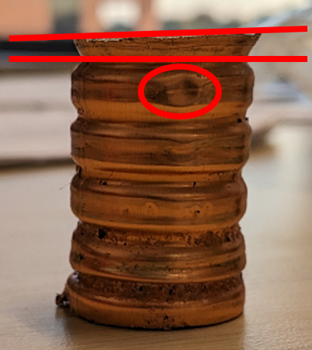
Reference clock rework (problem)
Reference clock cable intermittent connections
Changes observed in cavity phase as seen by beam
Fluctuations (a few tenth of a dB) of S21 measurement were observed when testing the cable
Upon inspection observed
Copper debris pieces were found when removing the old connector from the cable; some larger than the ones shown in the pictures
Inner conductor was deformed
Carefully re-terminating cables and prying open the inner conductor pins resolved the issue
Debris inside connector
Deformed connector shell
Good connector
Bad dented connector
Slanted cut and dent

Slide 12
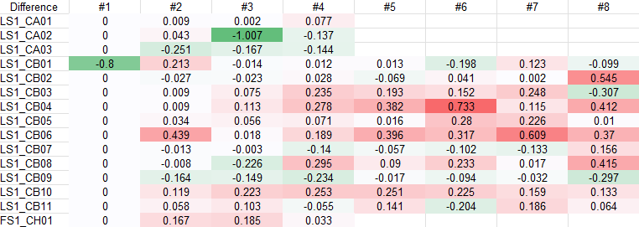
Reference clock rework (phase measurement methods)
Method 1 (blue)
FieldFox (handheld vector voltmeter)
Less efficient (a whole day for the linac)
Only one test equipment available
Need to write down the measurement and enter in a spreadsheet
Method 2 (green)
Use a spare channel of one LLRF controller in each rack
More efficient (1 hour or less for the linac)
Using Python script to record measurement directly from PV
Using Python script for post processing (get results within minutes)
Relative measurement compared to cavity 1
No information about phase difference between cryomodules
FieldFox
(VVM)
Patch Panel 1
LLRF 1
Patch Panel 2
LLRF 2
Patch Panel 3
LLRF 3
Patch Panel 4
LLRF 4
Patch Panel 5
LLRF 5
Patch Panel 6
LLRF 6
Patch Panel 7
LLRF 7
Patch Panel 8
LLRF 8
Phase difference between
Sep 2024 and May 2025

Slide 13
Beam Based Feedback Need
Used during operations while delivering record uranium-238 and selenium-82 beam
The beam-energy feedback system monitored fluctuations in the thickness of the liquid lithium charge stripper and compensated for these effects
It includes a super-conducting accelerating cavity and a bunching cavity upstream of the charge stripper, which correct the beam energy and arrival phase variations, making the beam energy constant after the charge stripper
https://doi.org/10.1103/PhysRevLett.128.212301
Carbon stripper used for beam power < 20 kW
Limitation with rotational speed and torque
Overheating at high beam power
Image of the uranium beam on the liquid lithium charge stripper film. The beam-on-target power is 20 kW. The relatively poor image quality is due to radiation damage to the camera imaging sensor.

Slide 14
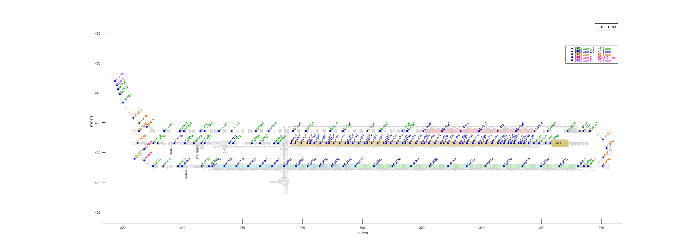
Beam Based Feedback Solution Developed To Compensate for Charge Stripper Induced Beam Energy Fluctuations
Collaborative effort
Directed by accelerator physicist
In collaboration with diagnostic
Measuring device
Beam position monitor (BPM)
Correcting device
LLRF controller
Timeline
Initial testing in May 2023
Correct arrival time only
Further testing in Dec 2023
Closed both loops
Response time ~150 ms
RFC D2152 phase is used to correct arrival time
RFC D1918 phase is used to correct beam energy
BPM Locations
LS3
LS1
FS1
LS2
Phase difference between BPM D2313 and D2248 is used for beam energy measurement
Charge strippers introduce beam energy fluctuations
BPM D2313 phase is used for arrival time measurement

Slide 15
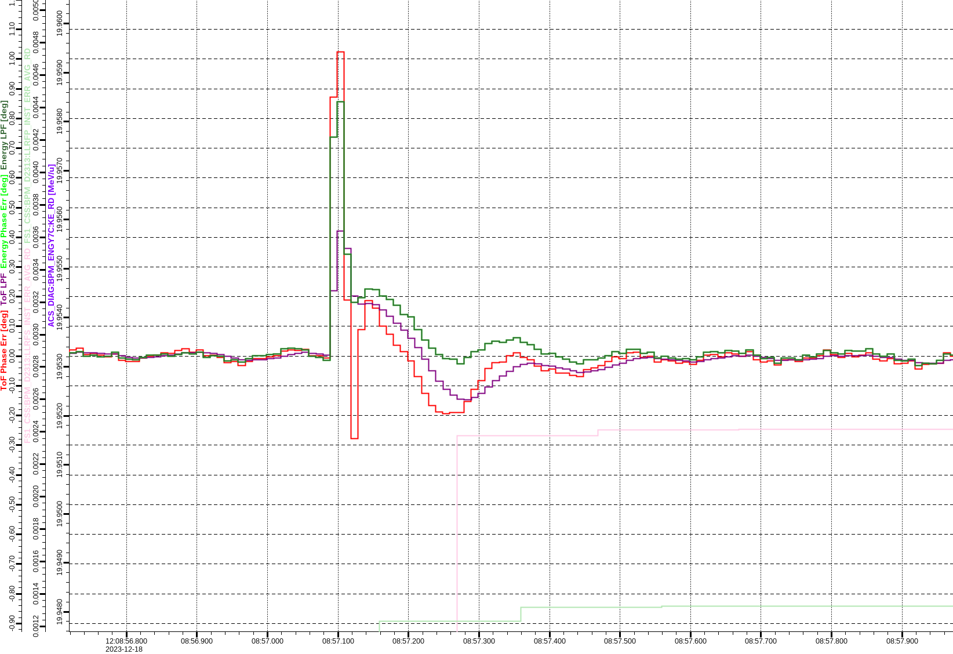
Beam Based Feedback Implementation Details
Network based feedback
BPM phase information is sent by the BPM input/output controller (IOC) to the LLRF controller through UDP packets every 10 ms
High phase ramp rate tested
LLRF phase ramp rate set to 1000 degree/s to allow fast correction
Control
Proportional-Integral (PI) control with pre-defined control limit
Exception handling
Disable feedback if lost of communication for more than 1 second is detected
https://doi.org/10.18429/JACoW-IPAC2024-THPG32
Peak phase error less than 0.2 degrees while adjusting cavity phase set-point
Arrival Phase Error
Energy Phase Error
Post-Stripper Energy
Both arrival phase error and energy phase error corrected in about 100 ms
0.1 º
100 ms

Slide 16
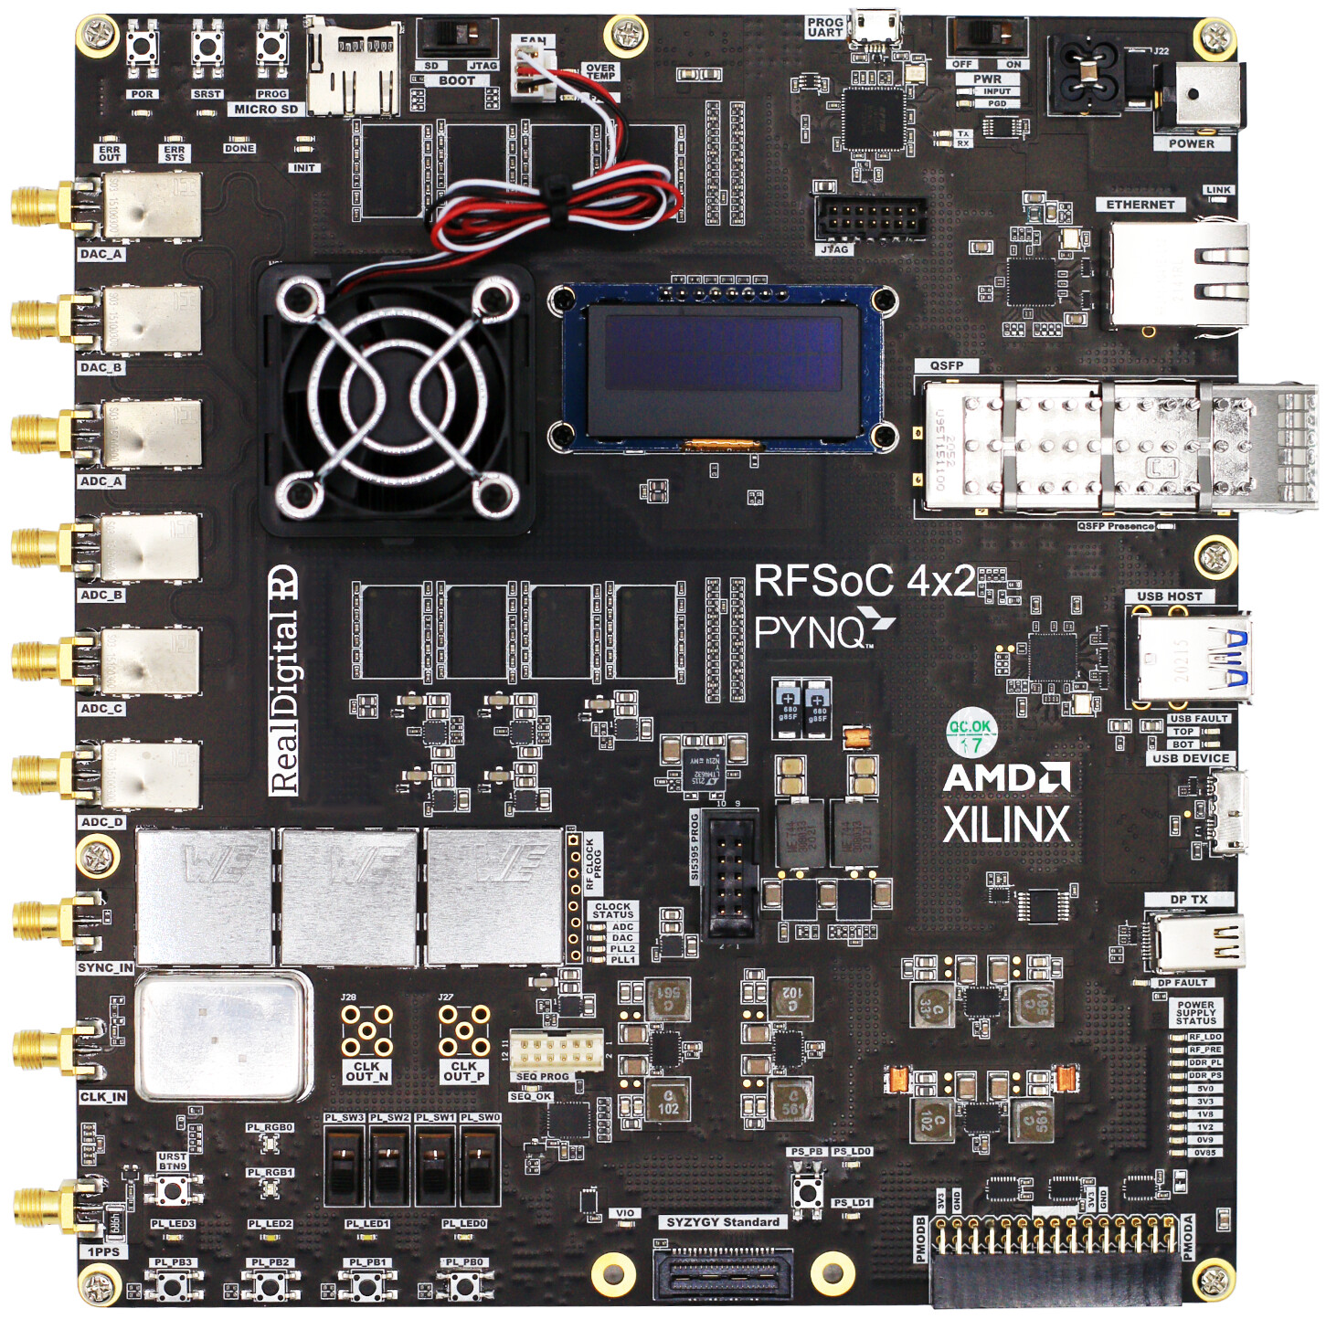
New LLRF Controller Prototyped
AMD-Xilinx Zynq UltraScale+ MPSoC
ZCU102 Evaluation Kit
Frequency supported
644 MHz FRIB upgrade cavity
5-cell elliptical cavity
1.013 GHz room temperature cavity
MSU Ultrafast Electron Microscopy lab
On board Input / output controller (IOC)
Less load per IOC
Less network traffic
Large local storage
500 GB Solid State Drive (SSD)
AMD-Xilinx Zynq UltraScale+ RFSoC
RFSoC Evaluation Kit
Potential application
K500 SEE
Cavity simulator
New LLRF Prototype
FRIB Beam Power Ramp Up
1. ZCU102; 2. RF board; 3. Tuner board; 4. Power supply; 5. Solid state drive.
RFSoC Evaluation Kit
https://doi.org/10.18429/JACoW-NAPAC2022-MOPA88

Slide 17
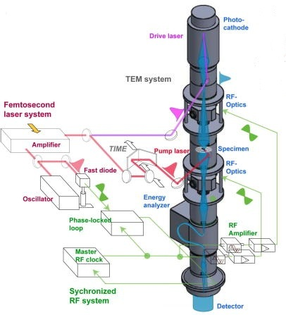
UEM Patent and Journal Publication
Precision-controlled ultrafast electron microscope platforms. A case study: Multiple-order coherent phonon dynamics in 1T-TaSe2 probed at 50 fs–10 fm scales
Improved temporal resolution
https://doi.org/10.1063/4.0000242
Interactive Cascade Phase-Locked Loop for High-Brightness Electron Beam System
Patent pending
The ultrafast electron microscope system with RF optics. Schematic of ultrafast microscope utilizing RF cavities as electron lenses in a TEM column to temporally and spectrally focus the photo-electron pulses generated at photocathode. The fs laser system provides timing to pump pulse initiating material transformation as well as for seeding the RF signals sent to the RF cavity that delivers the short electron probe pulses. A phase-locked and control loop serves to ensure laser and RF are synchronized to each other. Adapted with permission from C.-Y. Ruan, Structural Dynamics with X-Ray and Electron Scattering (The Royal Society of Chemistry, 2023). Copyright 2023 RSC Publishing.

Slide 18
Summary
Keep improving operation efficiency and reliability of RF system
Achieved > 98% RF availability and supported high-impact experiments
LLRF System Enhancements
Fast waveform analysis aids in trip diagnostics and daily automated reports streamline troubleshooting and shift coverage
Calibration & Quality Control Improvements
Addressed amplitude and phase calibration issues with targeted fixes and reference clock rework resolved connector-related phase instabilities
Beam-Based Feedback Development
Compensates for charge stripper-induced energy fluctuations and closed-loop feedback with < 0.2° phase error and ~150 ms response time
Future Directions
New LLRF controller prototyped with FPGA SoC platform
Continued focus on automation, reliability, and support for advanced applications

